Slide 1


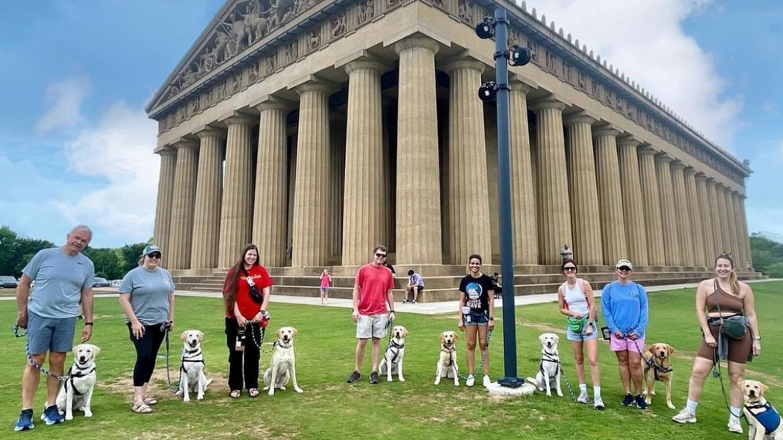
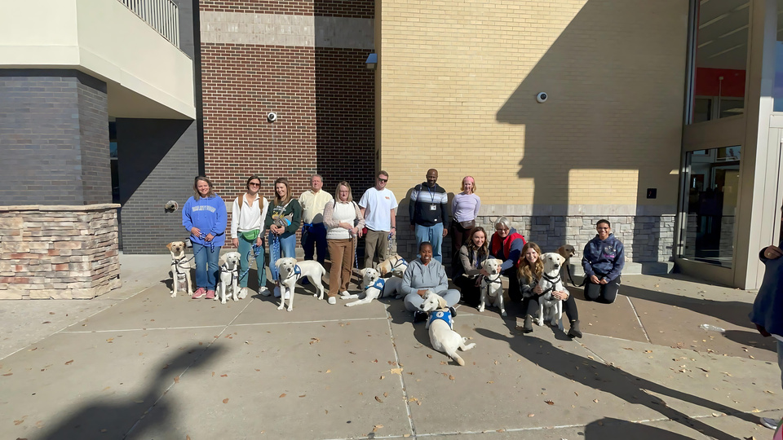
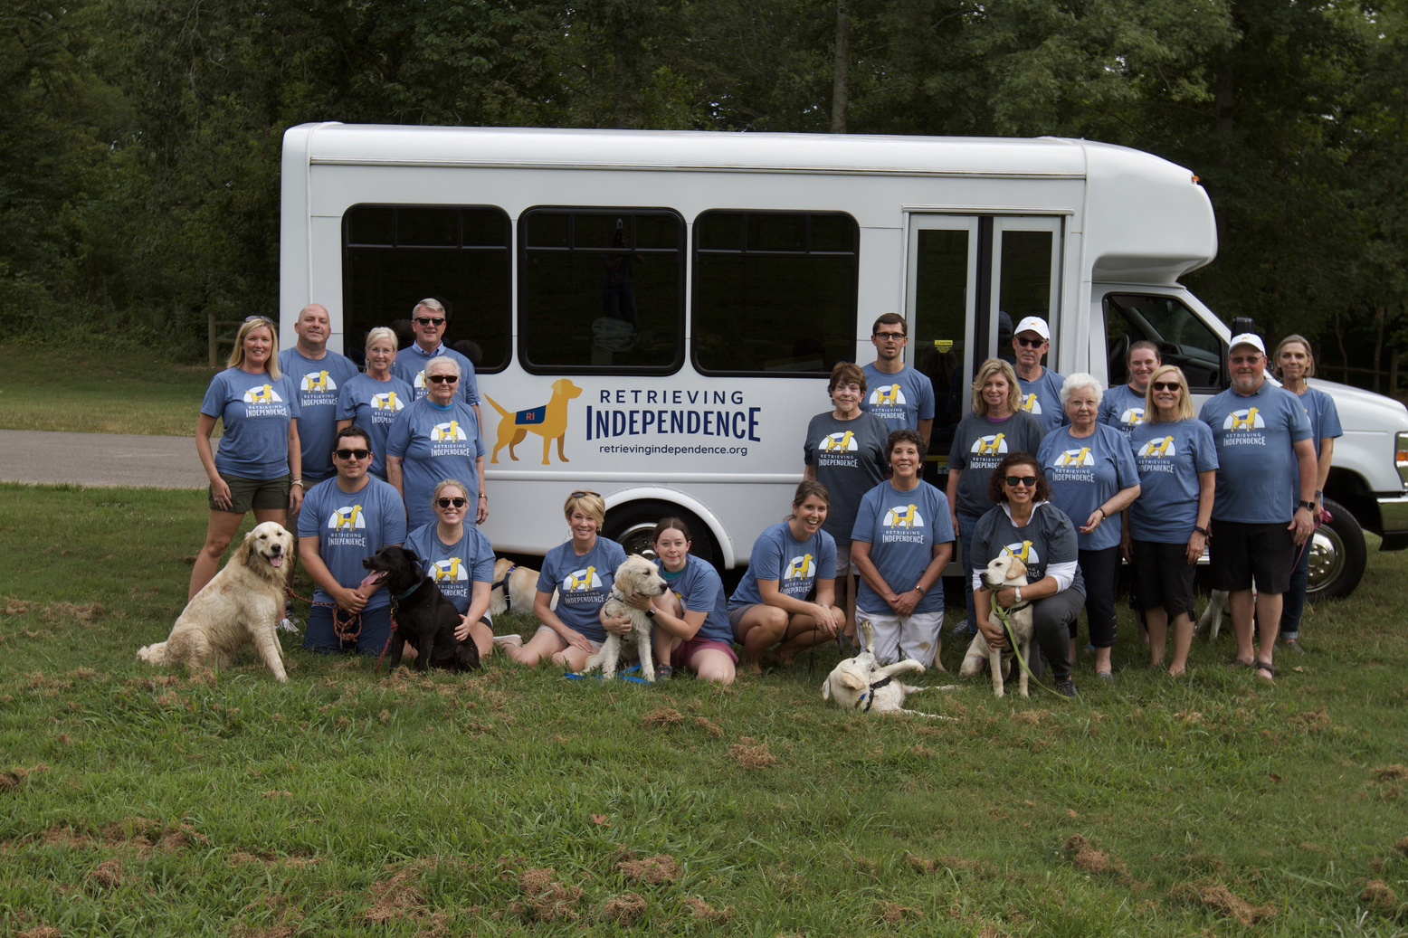
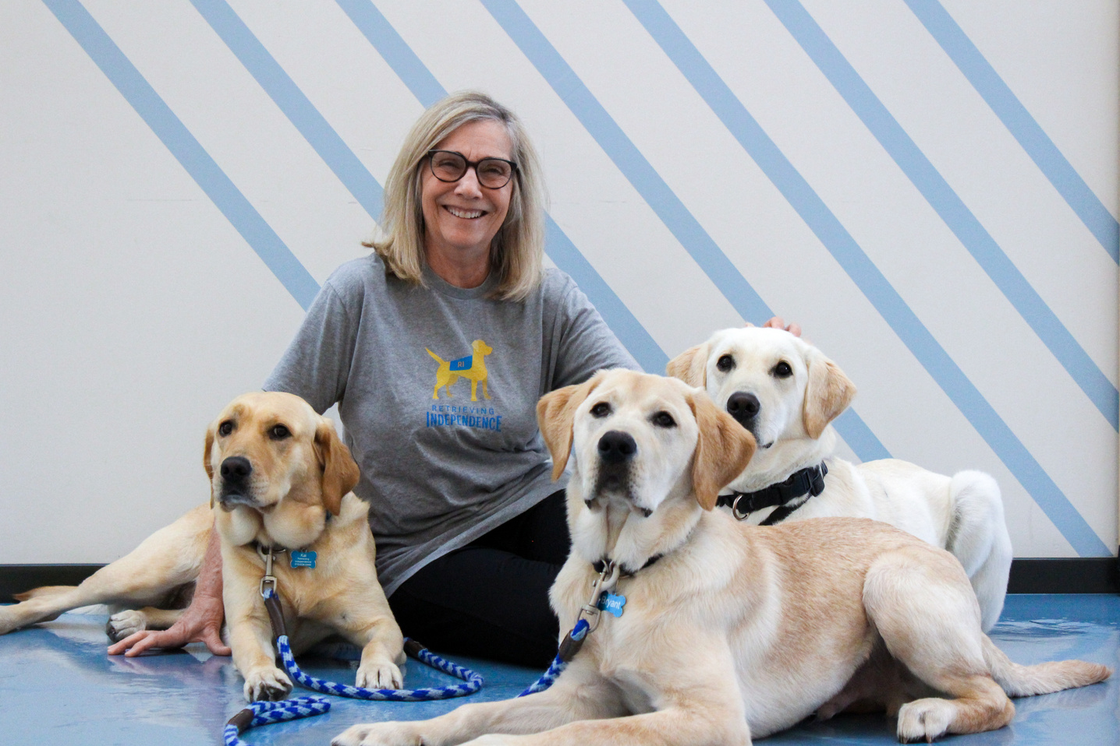
Grant Proposal for Retrieving Independence
LOVE. DIGNITY. CHANGE.
About Us
We are a service dog nonprofit based in Nashville that was founded in 2012.
Our mission is to increase independence & restore dignity through the placement of working dogs.
Who We Serve
Individuals with physical, cognitive, or psychiatric disabilities.
Incarcerated individuals participating in purpose-driven skill development.
Schools & youth organizations supporting student well-being.
Our Programs
Service Dogs
Skilled Companions
Facility Dogs
Prison-based training model
Scope of Impact
85+ active working dog teams
30+ dogs in training
100+ placed since 2012
November 2025

Slide 2


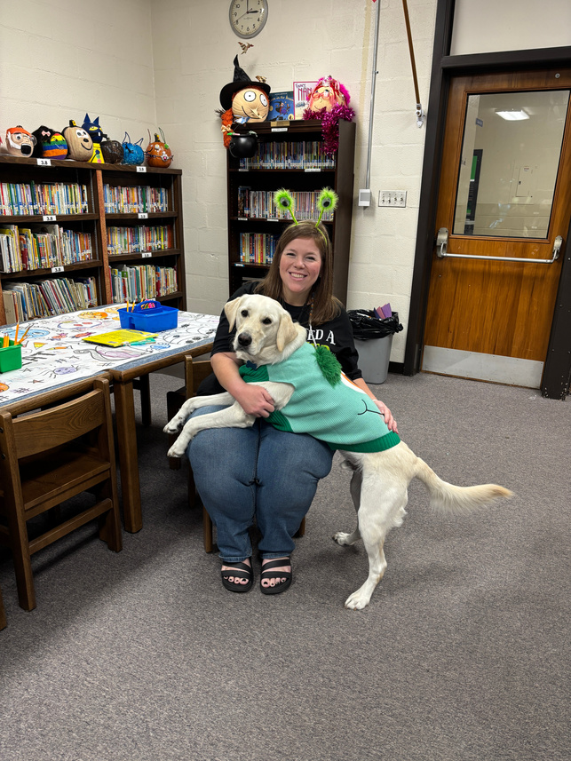
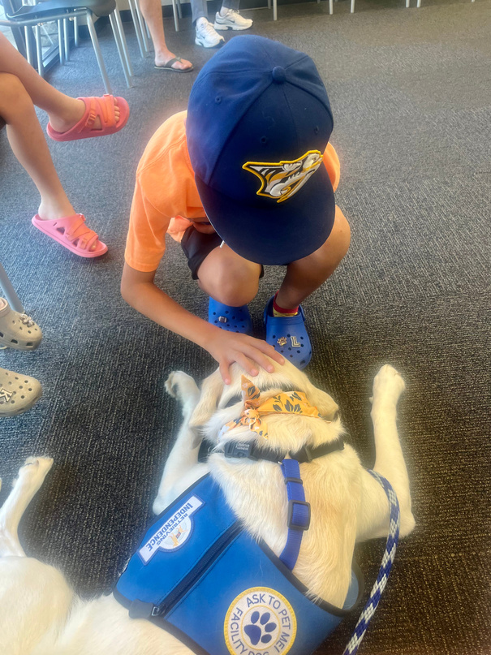
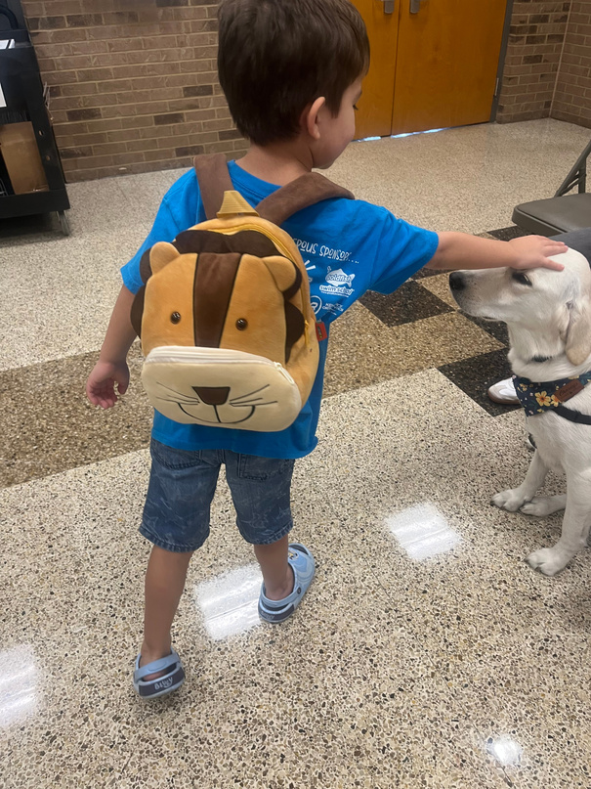
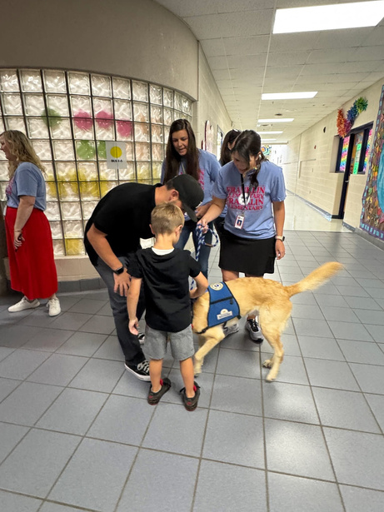
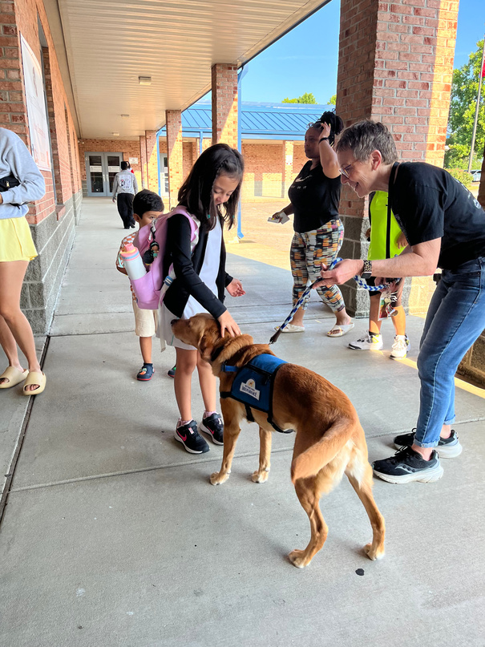
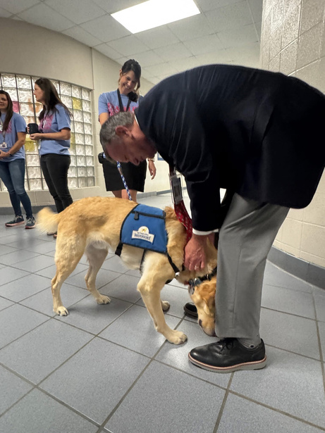
Our Impact on
Both Ends of the Leash
Clients & Community
Enhanced daily independence, improved mobility & stability
Facility Dog Program (est. 2021) supporting children, families, & care teams
100+ volunteers contributing 12,000+ service hours annually
ADI accreditation in December 2025
Incarcerated Trainers
Purpose-driven roles providing emotional growth and vocational skill development
Professional dog-handling and training experience transferable post-release
0% recidivism among program graduates over the past 5 years

Slide 3

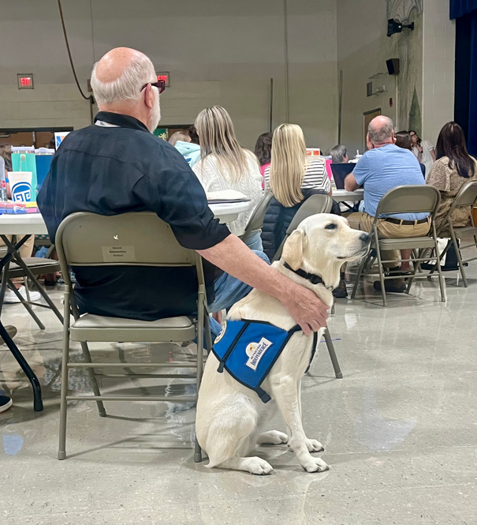

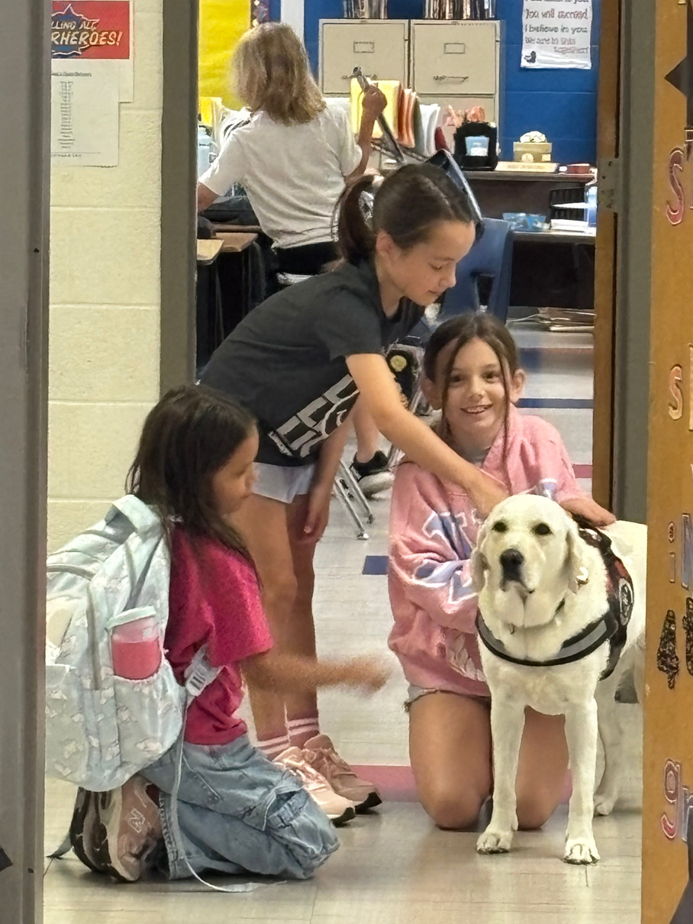
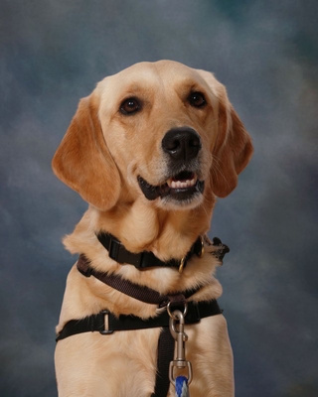

Funding
Request:
We are requesting $35,000 from Impact100 Nashville to support the placement of 5 new Facility Dog teams to meet growing community need.
Advanced training and daily care needs
What this funding
directly covers:
Enrichment & working equipment
Veterinary support & wellness
First-year support for each handler & host org.
Reduces the current waitlist
(6 schools & 5 individuals awaiting placement)
Community
Impact:
Expands emotional, behavioral, and resilience support for children and families

Slide 4


Where One Dog Impacts Many Lives
Youth & Schools
Each Facility Dog supports 1,400+ students annually
Serves youth with disabilities, trauma, and emotional regulation needs
Improves student engagement, emotional stability, and overall well-being – research conducted at Georgia Southern University found that dogs in classrooms encouraged increased reading and language skills; social, emotional; and improved gross motor skills
Supports teachers and staff by providing a calming presence and effective tool for de-escalation
Economic & Workforce
Four formerly incarcerated trainers now working full-time in the dog training field
Demonstrates successful re-entry, vocational transferability, and long-term stability
Long-Term Goal → scale to more schools and organizations in Middle Tennessee

Slide 5

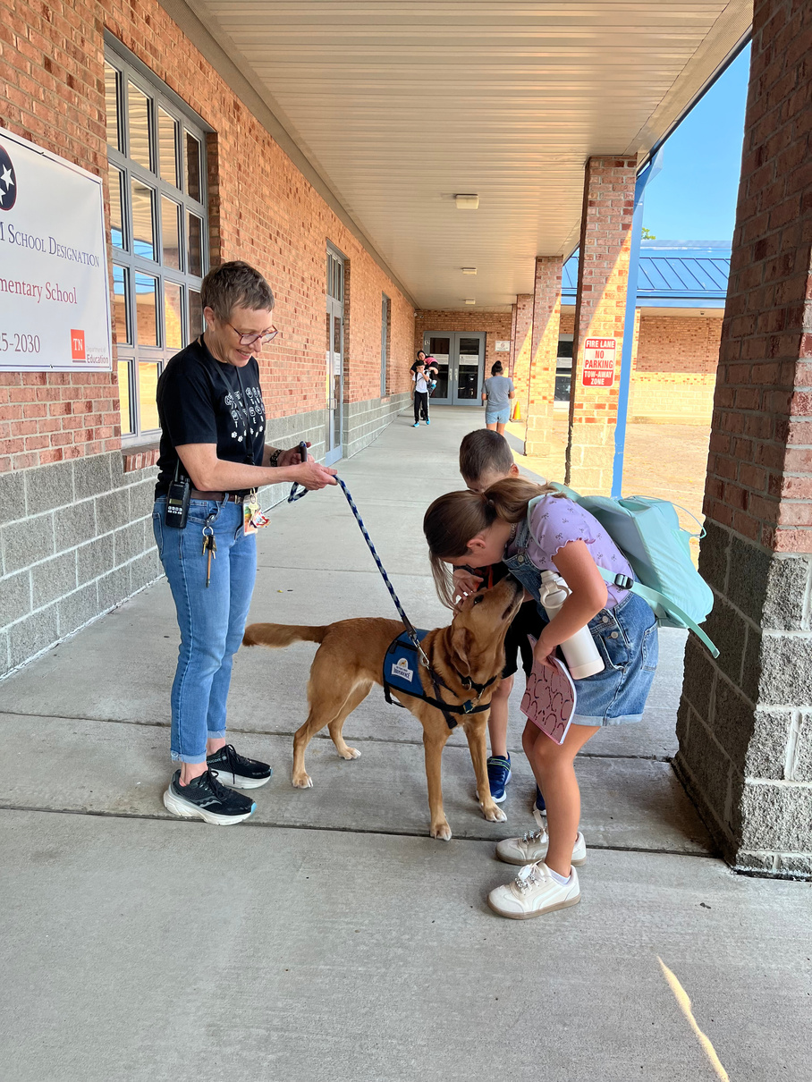
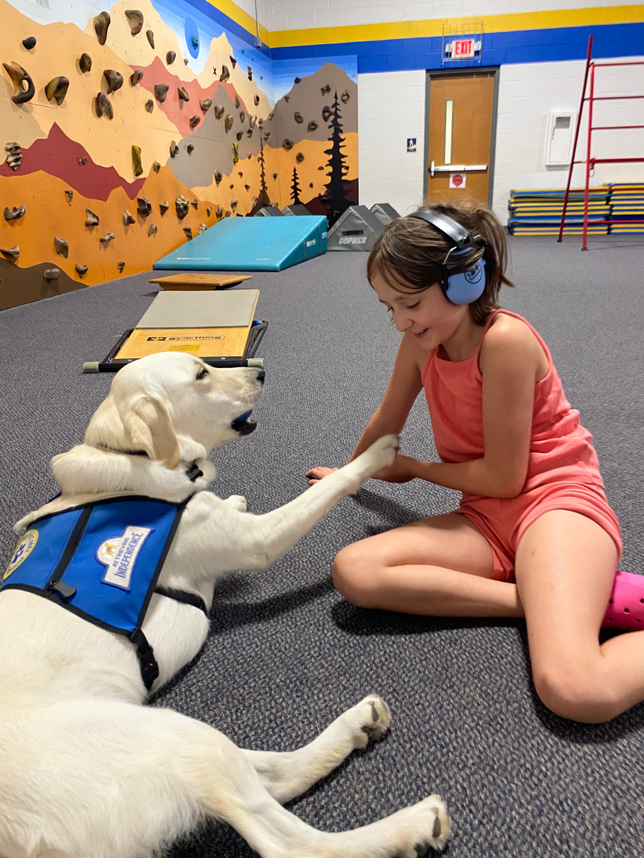
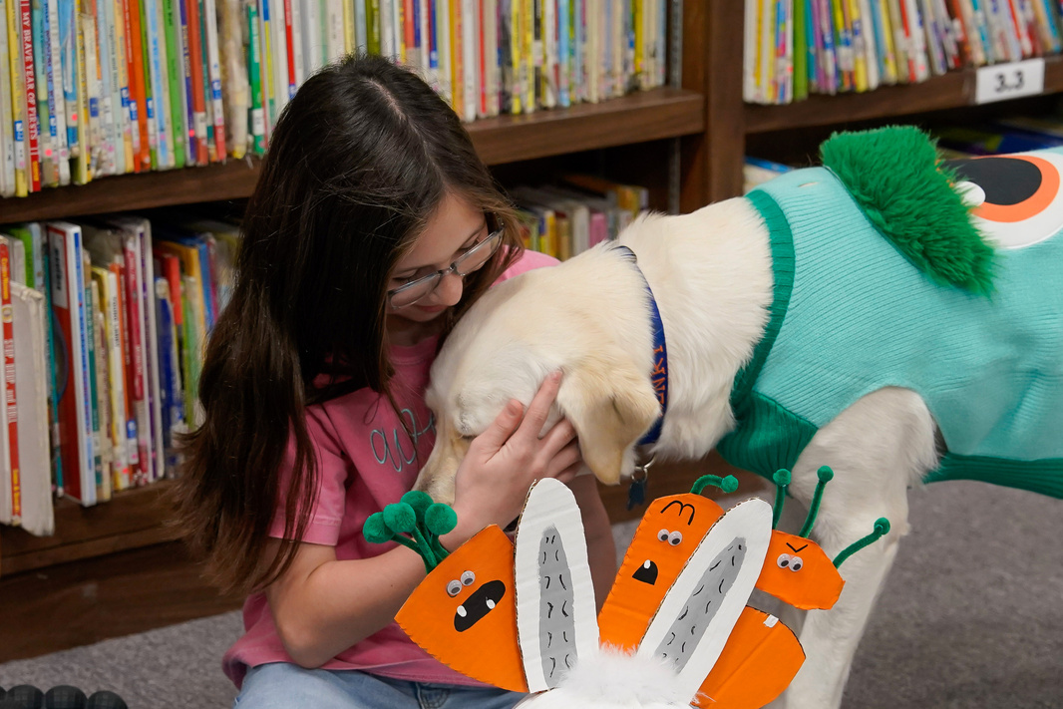

“Junebug brings joy & healing; lowers stress on sight.”
– Facility Dog Handler
“RI dogs provide tremendous support to students.”
– Franklin Special District
“I’ve gained independence & confidence.”
– Service Dog Client
Thank you for your consideration.

