Slide 1


Impact100 Nashville
Grant Presentation
November 13th, 2025

Slide 2
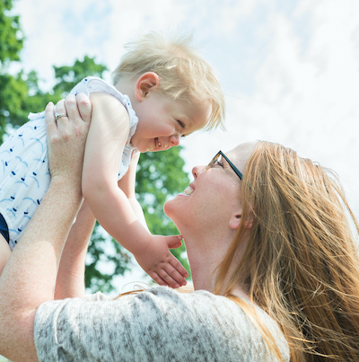



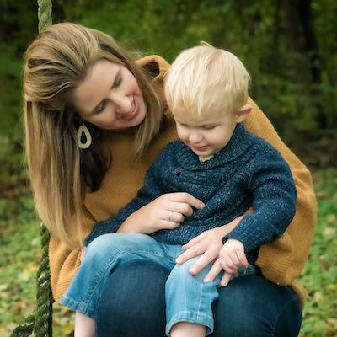
The BEST Story
Our Mission
BEST started with two moms on a mission…
Ensure that families are empowered and equipped through specialized programs of support to provide young children who are blind or low vision their BEST start in life.
BEST Start
BEST Together
BEST Advocate
In-home early intervention tailored to each family's unique goals and needs for comprehensive vision support.
BEST Together builds community through family events and programs, creating lasting support networks.
Expert guidance for families navigating the transition from early intervention to school-based services.

Slide 3
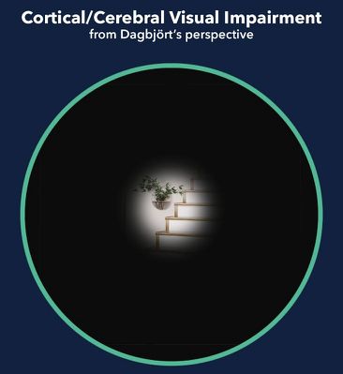

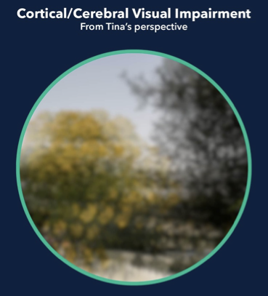
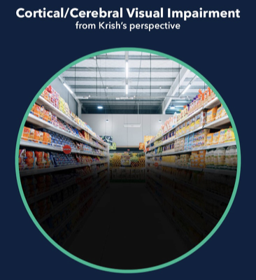

The Need
Complex and Individual
Each CVI case is unique - damage from strokes, seizures, traumatic brain injury, cerebral palsy, and autism creates varied visual experiences that often go undiagnosed.
CVI
The Importance of Early Intervention
Cortical Visual Impairment is the leading cause of childhood blindness, affecting 1 in 30 children. Unlike ocular impairments, CVI is brain-based damage to the visual pathway.
When caught early with specialized interventions, vision can become more functional. The challenge: tailoring interventions for children who cannot tell us how they see.

Slide 4
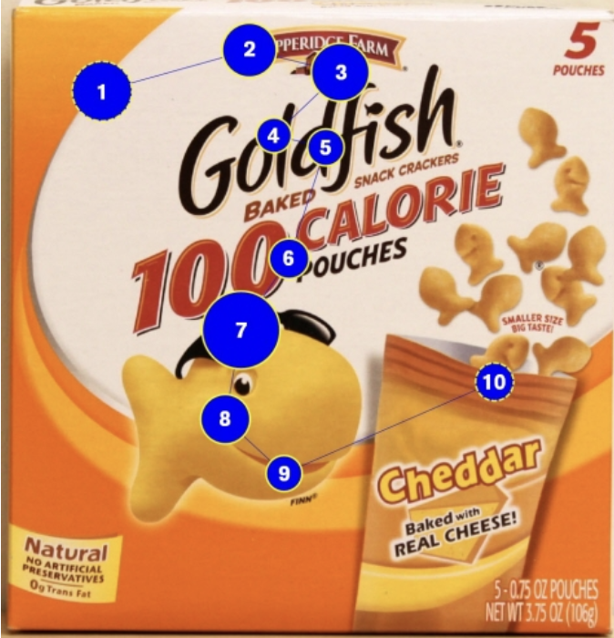
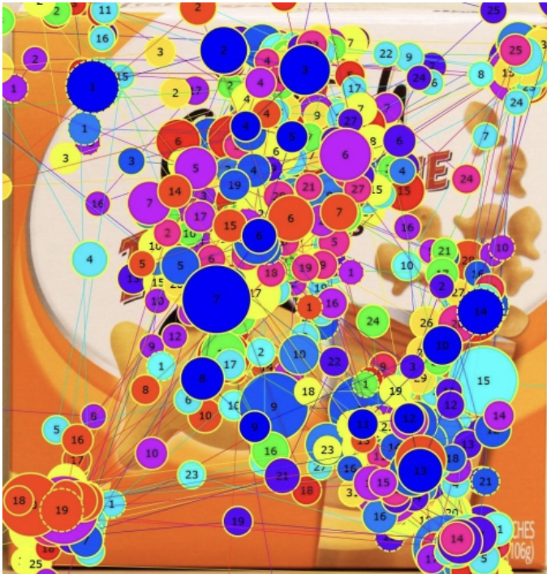
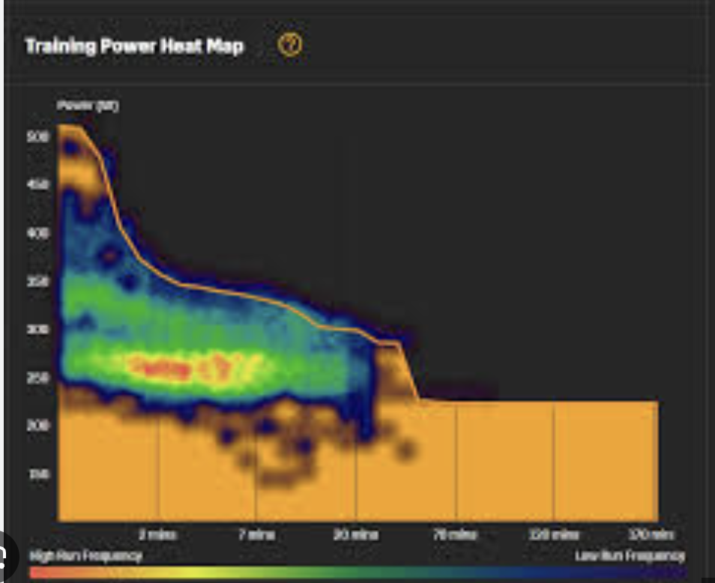
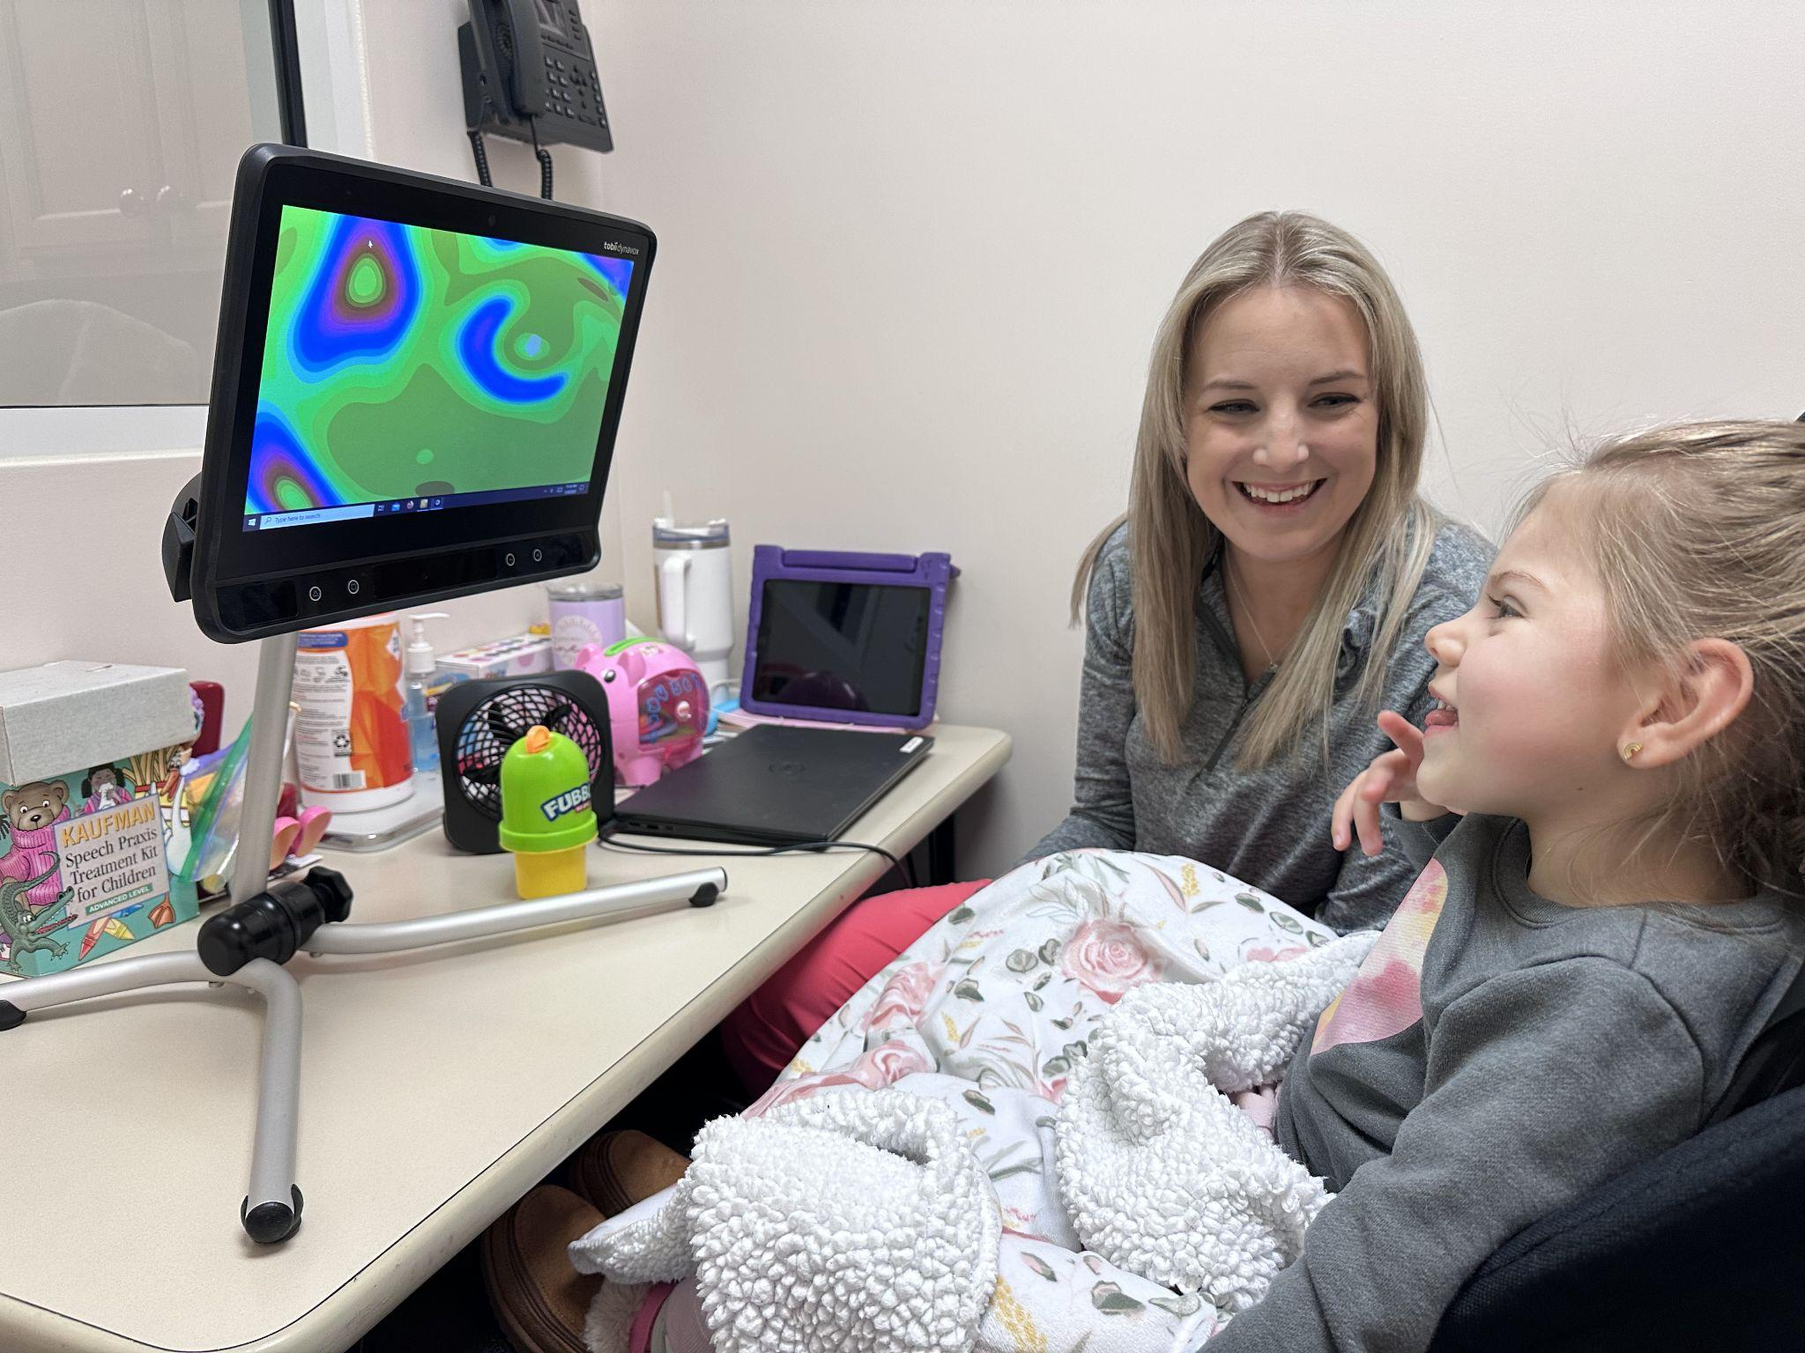



The Solution
Analyze Vision Patterns
Tailor Interventions
Capture Visual Data
Heat maps and gaze plots reveal where children fixate, how long they maintain gaze, and response times to visual stimuli with precise measurement.
Replace trial-and-error approaches with data-driven interventions, maximizing crucial developmental time for both child and brain development.
Understand how color, light, motion, contrast, environment, etc. affect focus, providing clear insights into each child's unique vision processing abilities.

Slide 5

The Impact
Early Identification
Family Empowerment
Provider Collaboration
Improved early identification and referral systems for brain-based vision conditions.
Clear insights for families to understand exactly how their child sees and processes visual information.
Support for Speech and Language Pathologists and other team providers to tailor their own interventions for the child
Data-Driven Intervention in TN
Statewide Leadership
Evidence-based early intervention specifically designed for children with CVI has proven successful in other states and will bring that expertise to Tennessee.
Strengthening BEST’s leadership as the only provider of vision-specific early intervention services in TN

Slide 6
Measurable Success
Quantitative Tracking Metrics
Qualitative Impact Assessment
Comprehensive data collection will measure the direct impact of eye-gaze technology implementation across all service delivery models.
Family and provider feedback will capture the transformative human impact of data-driven vision intervention approaches.
●
Total number of children served using new eye-gaze technology devices
●
Family satisfaction and empowerment through understanding their child's vision
●
Number of intervention sessions utilizing the advanced eye-tracking equipment
●
Provider confidence and effectiveness in delivering targeted interventions
●
Measurable improvements in functional vision development and progress tracking
●
Long-term developmental outcomes and quality of life improvements for children

Slide 7

Thank You!
www.blindearlyservices.org
615-200-8006
aclougherty@blindearlyservices.org
lmcwhorter@blindearlyservices.org
@blindearlyservices (IG, FB, YouTube)

